Slide 1




Presented by
Vaishnavi Choukwale, Abhilash Gorle, Abhinav Gupta
(002816622)
(002817565)
(002290559)
Pennies
A Tax Management and Tracking Application

Slide 2
Problem:
Fiscal
Transperancy
The lack of accessible information on budget allocation and tax utilization hinders citizens' understanding of government functioning, resulting in confusion and mistrust of government.

Slide 3
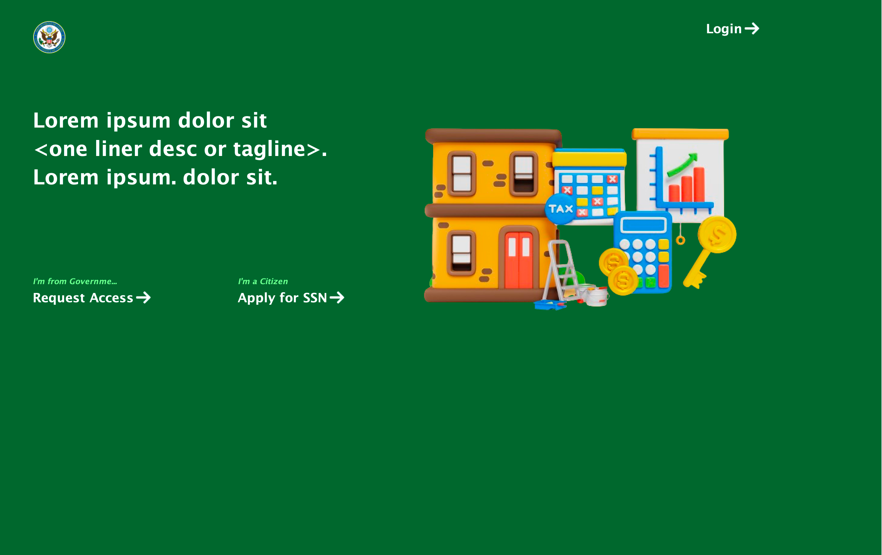
Solution:
Pennies
Tax management application
This project addresses the gap between citizens and their government by providing a comprehensive platform to track and manage tax money.

Slide 4



Budget Allocation
Tax Payment
Citizens can upload expenses, investments, and income to calculate taxes and pay directly to the government
Government can view intelligence regarding the tax money flow and dynamically allocate.
Objectives
and Features
Tracking Money
Government Accountability
Citizens can raise complaints directly to specific departments and question their decisions
Both the government and its citizens can track the distribution of tax money and suggest changes

Slide 5
Key Functionalities
Citizens
Apply for SSN
and login
Log complaint to specific departments
Dashboard for tax money flow
Add financial information and pay taxes
Government
Request access
and login
Allocate budget
to multiple departments
Emergency funds provision
View and address complaints

Slide 6
Proposed Entities
Enterprises
Organizations
Departments
Roles
Health Ministry
Infrastucture
Construction
Equipment Production
Leaders
Education Ministry
Research & Development
Utility Services
Managers
Defence Ministry
Trucking and Leisure Transport
Resource Management
Citizens
Transportation Ministry
Worker Union

Slide 7
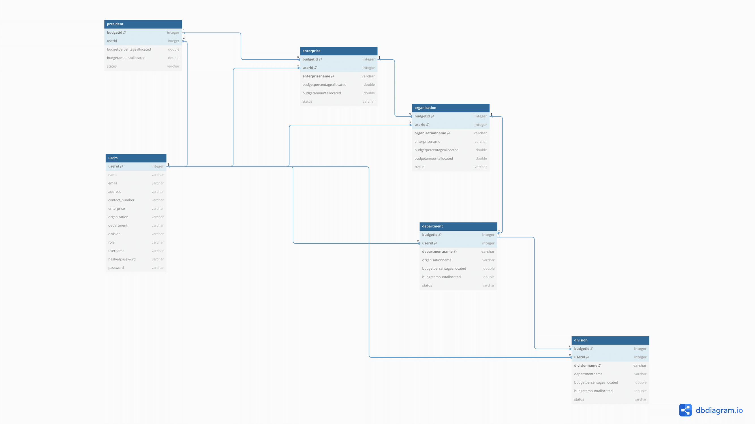
Class
Diagram

Slide 8
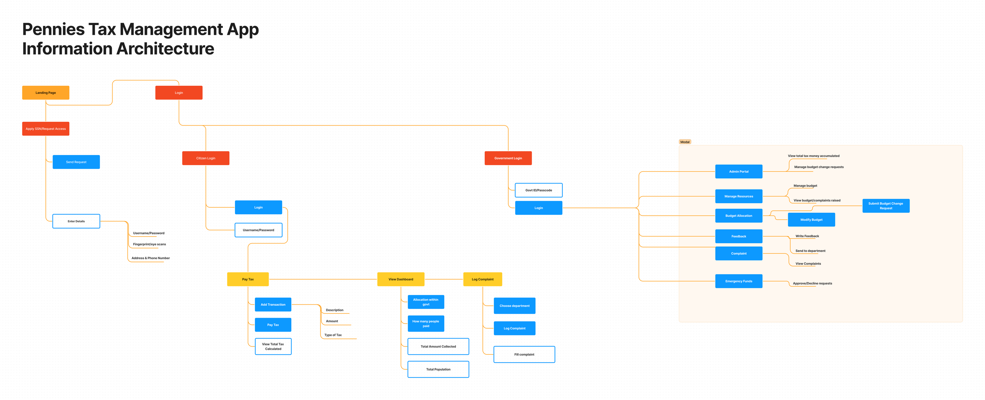
Architecture Diagram

Slide 9
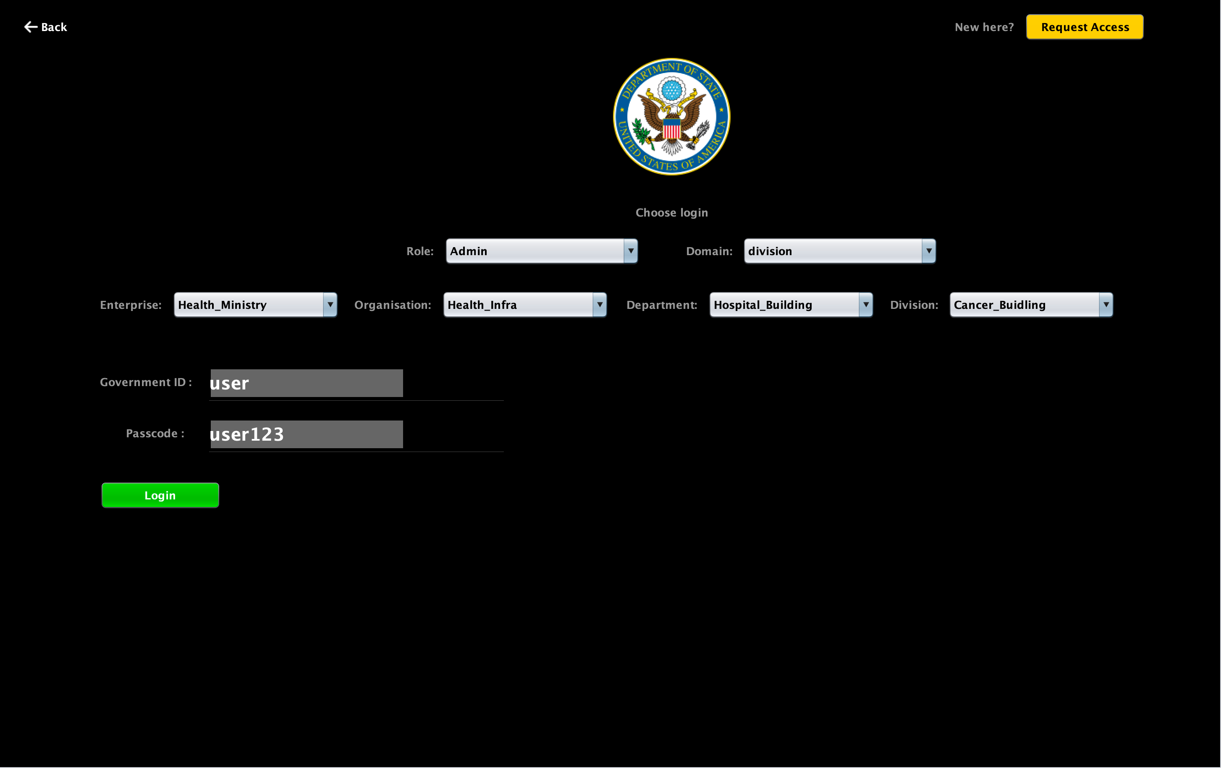
Product Use Case 1:
Government officials/Citizens can register and login

Slide 10
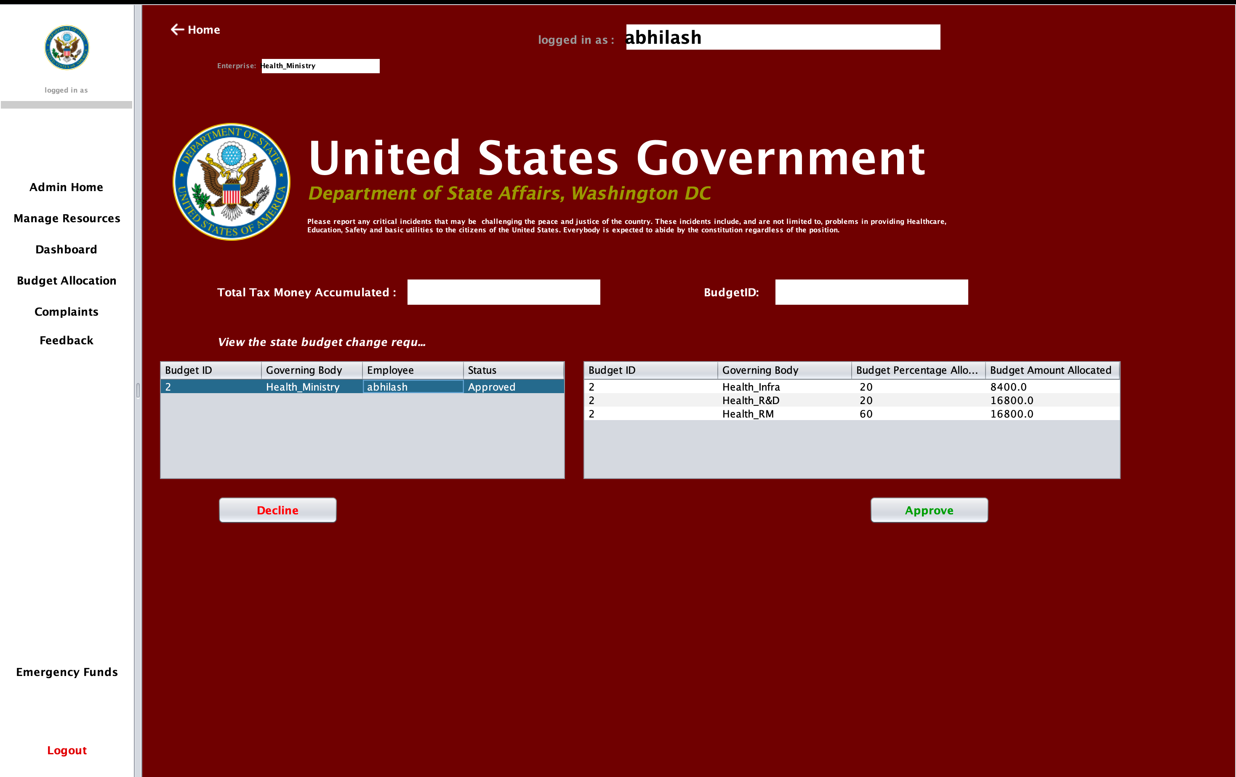
Product Use Case 2:
Leaders can approve/decline requests for budget changes

Slide 11
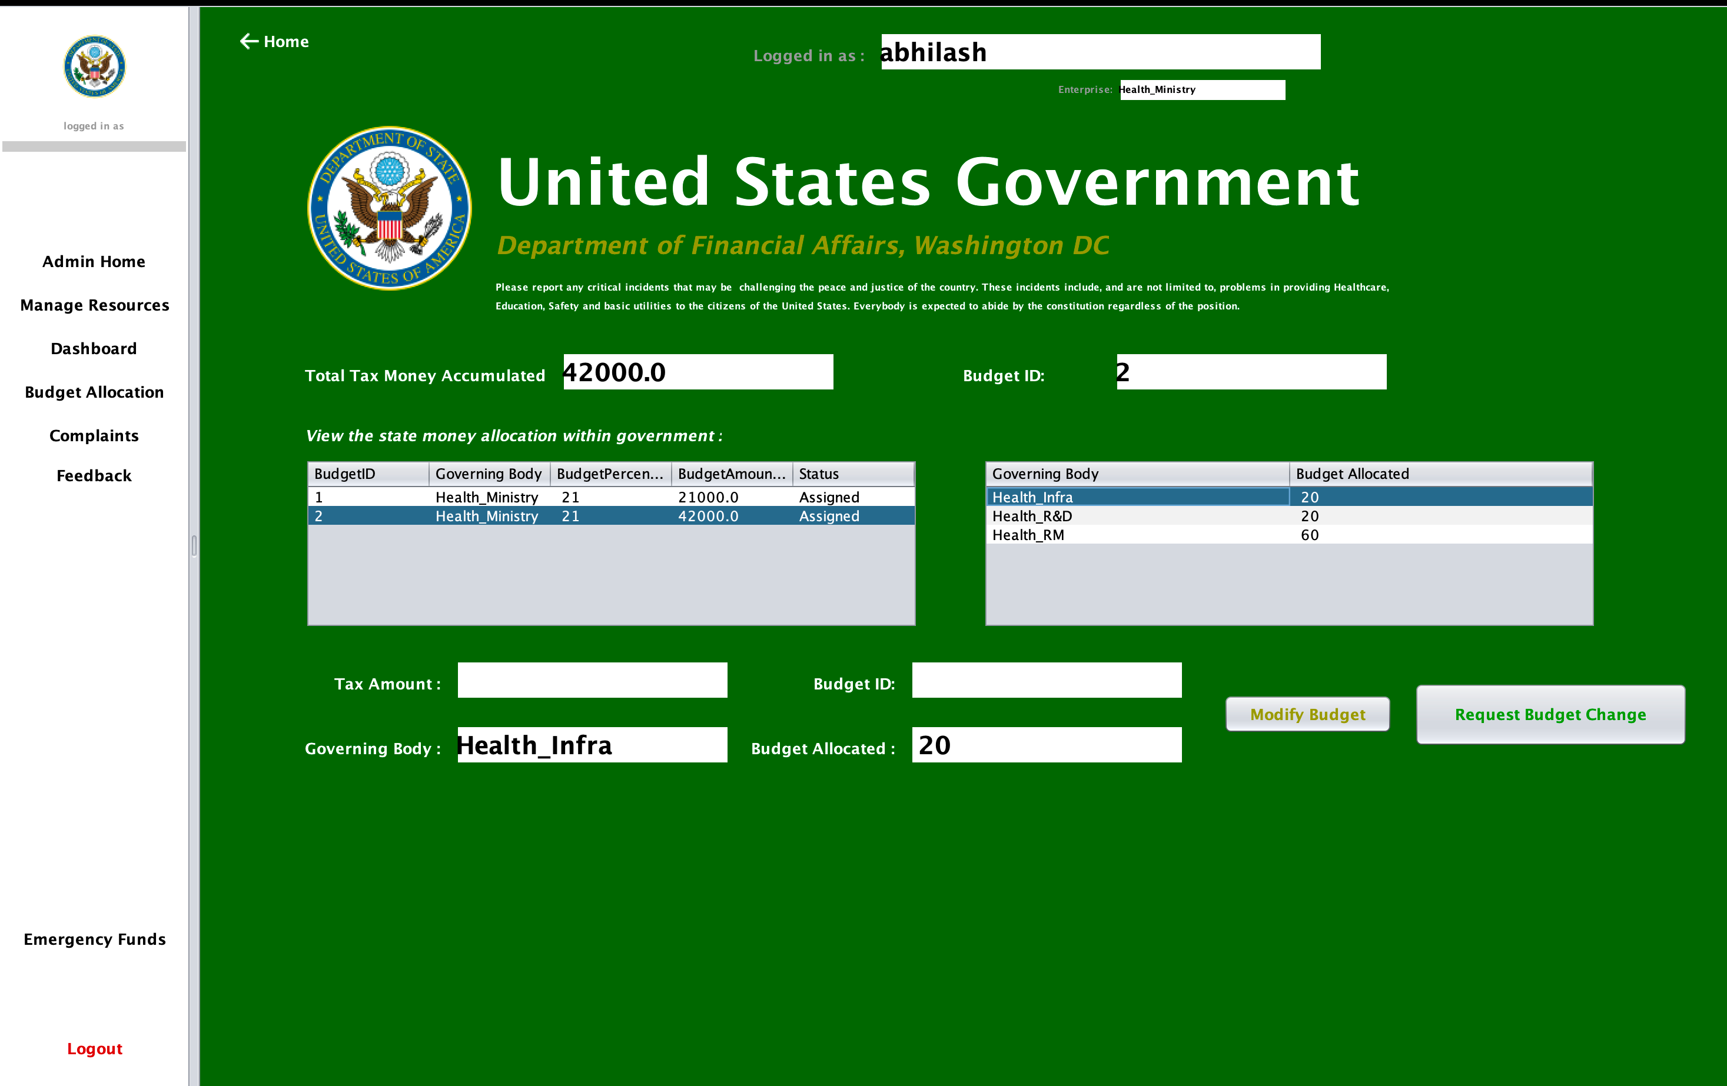
Product Use Case 3:
Government can view intelligence reports & dynamically allocate budget.

Slide 12
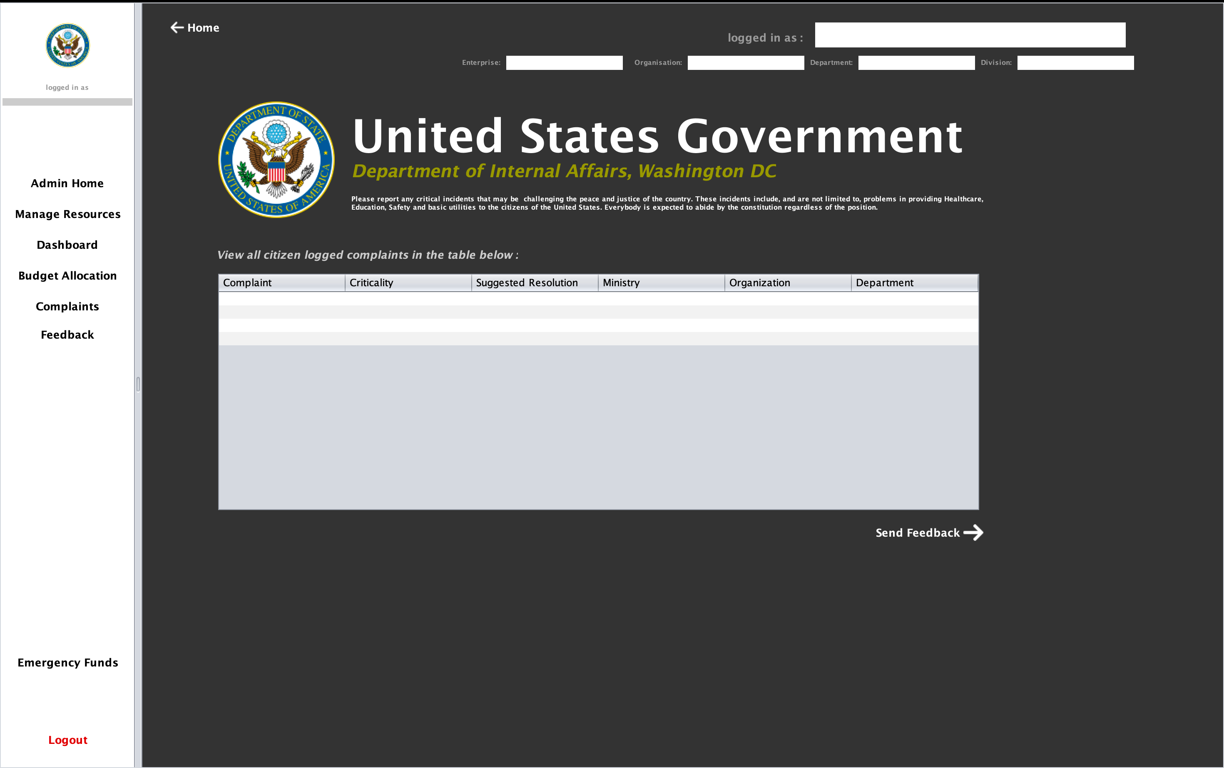
Product Use Case 4:
Government can view complaints raised and provide feedback internally

Slide 13
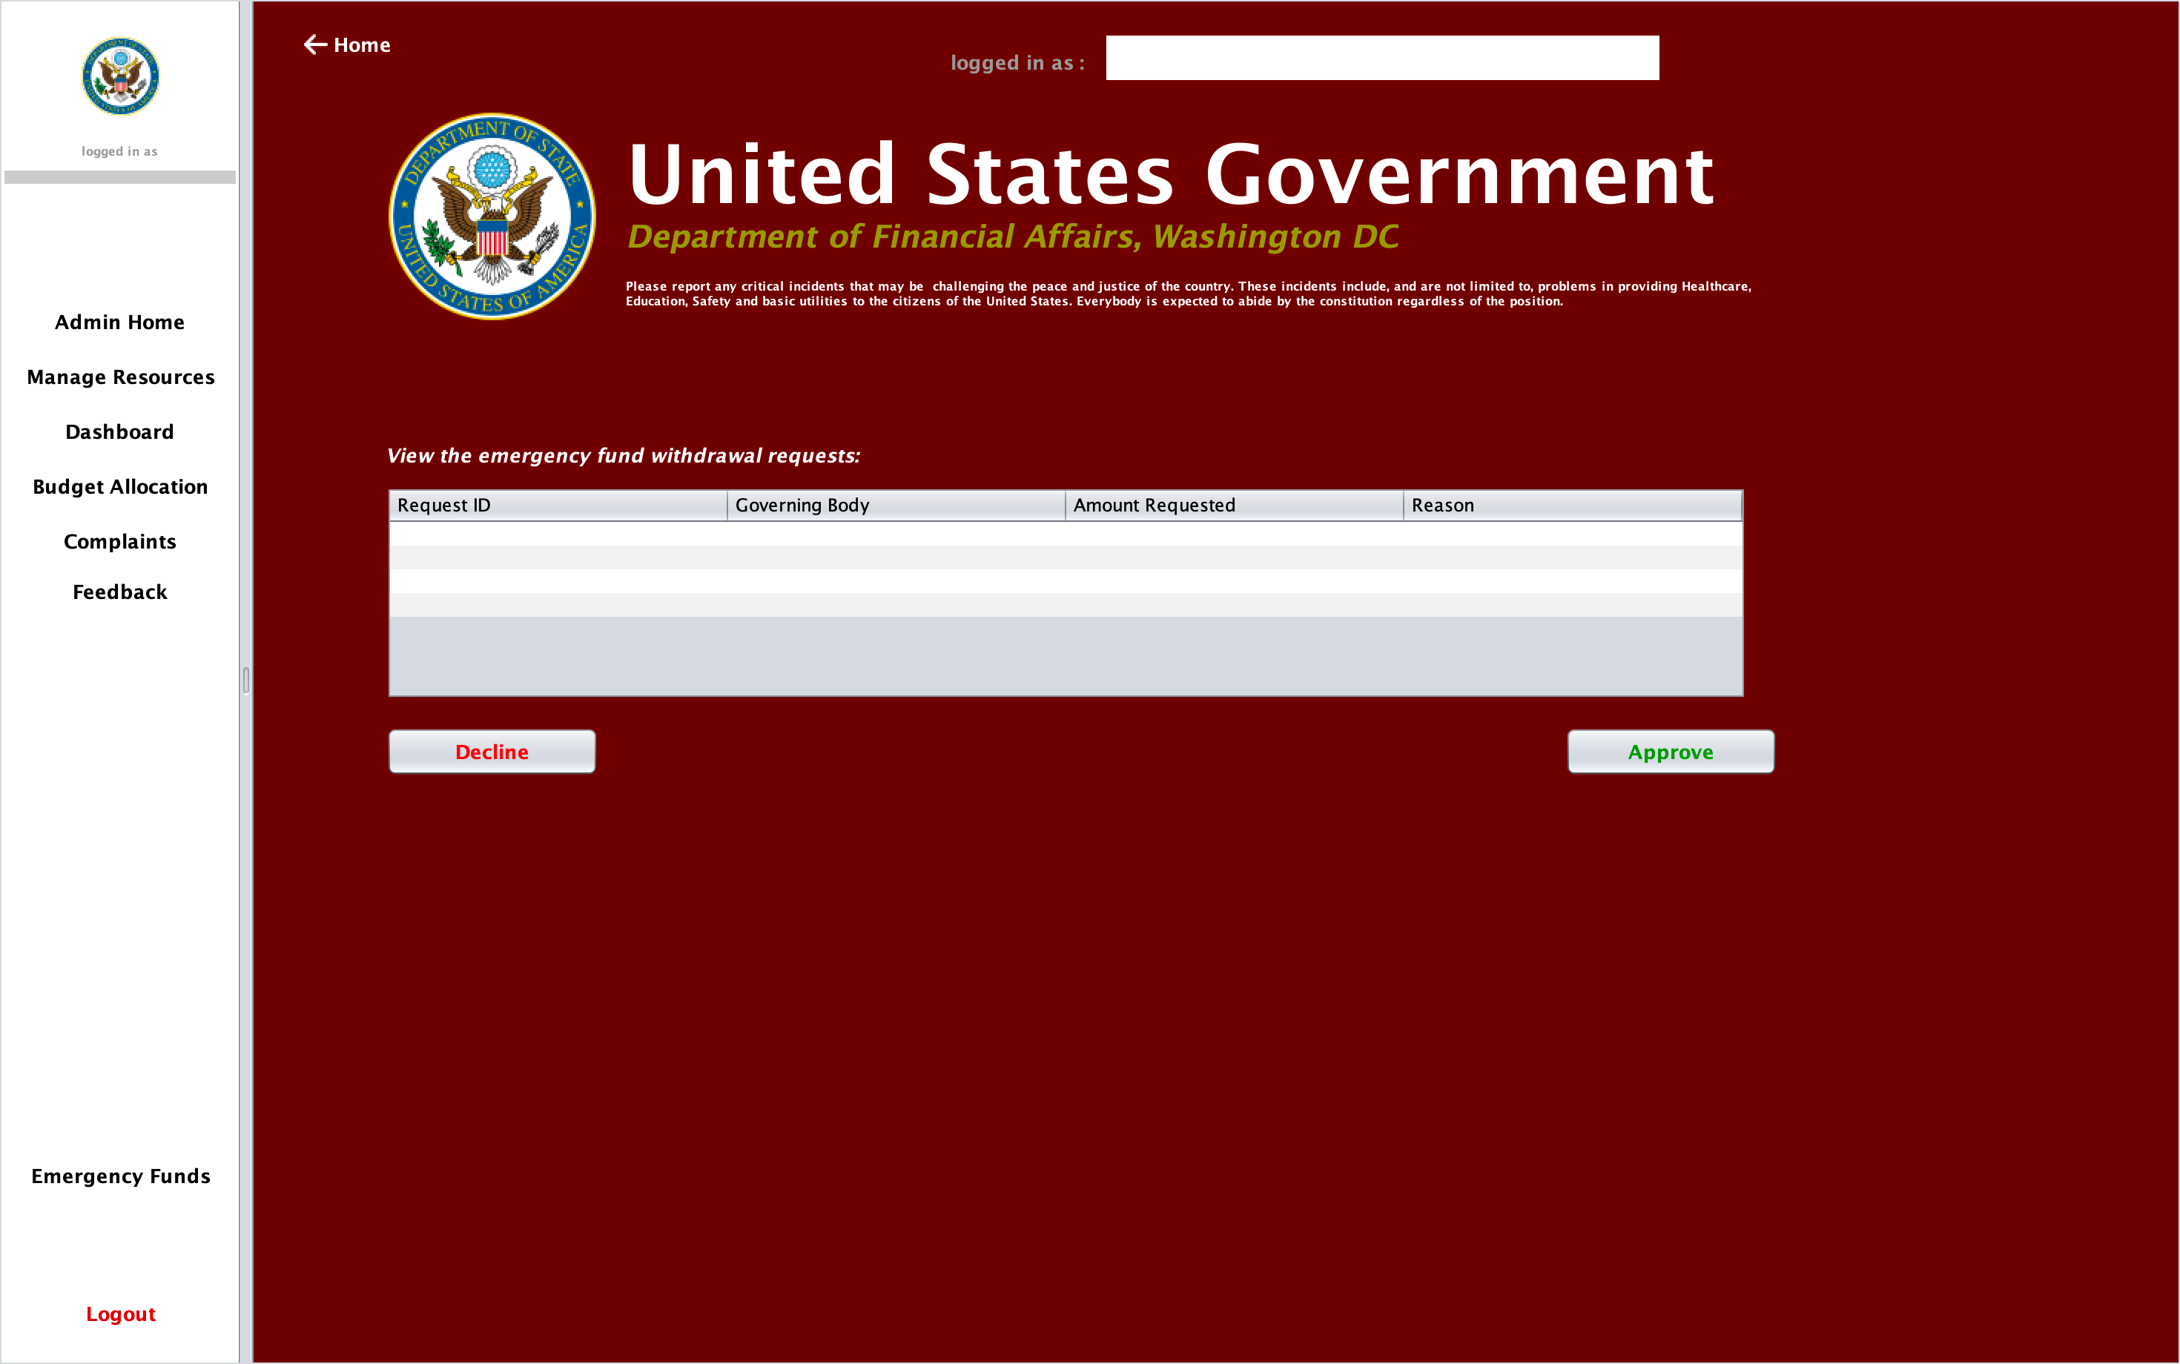
Product Use Case 5:
Government can approve/decline request for emergency funds

Slide 14
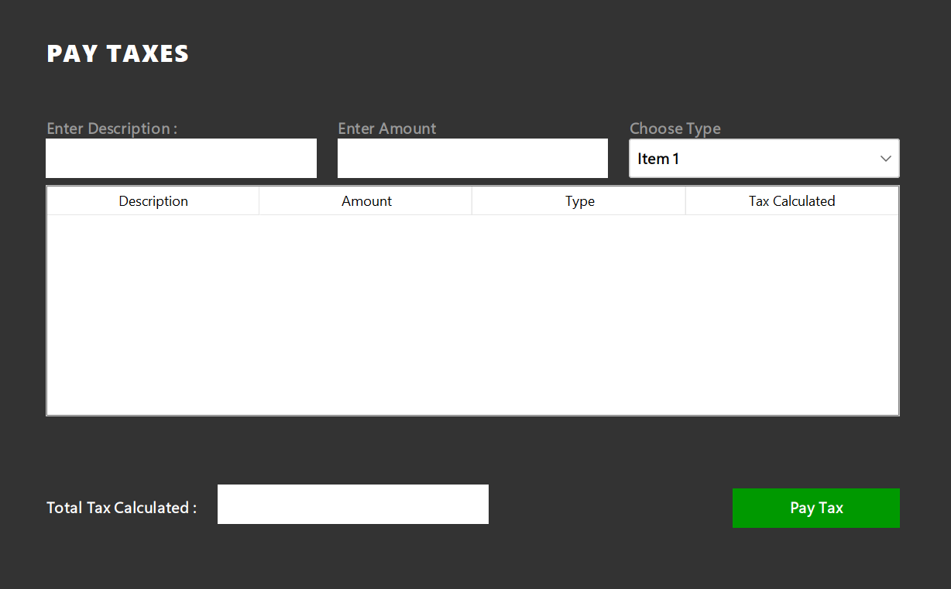
Product Use Case 6:
Citizen can add financial information and pay tax

Slide 15
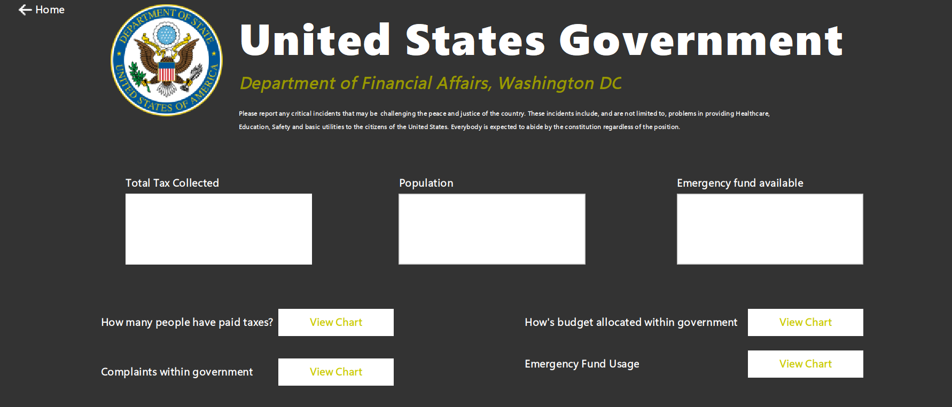
Product Use Case 7:
Citizens can track the flow of tax money within the government

Slide 16
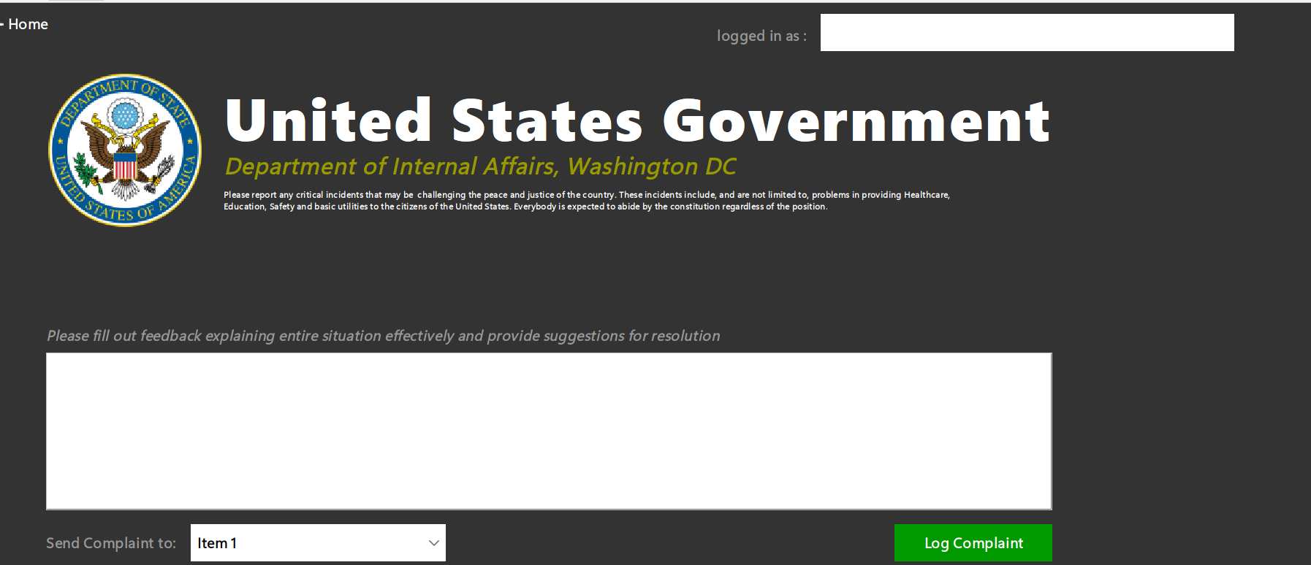
Product Use Case 8:
Citizens can raise complaints highlighting specific issues and prompting budget changes

Slide 17
Conclusion:
The future of Taxes
We believe such transparency would increase the involvement of citizens, and more people would be paying taxes judiciously.
Such support from the public can also help the government in decision-making to ensure peaceful communities

Slide 18
Presented by
Vaishnavi Choukwale, Abhilash Gorle, Abhinav Gupta
(002816622)
(002817565)
(002290559)
Thank you very much!

